Slide 1

Direct extraction of path weak values from interferograms without auxiliary qubits
Ismaele Vincent Masiello

Slide 2
Content

Slide 3
Content
Part 1: Introduction to weak values and weak measurements

Slide 4
Content
Part 1: Introduction to weak values and weak measurements
Part 2: Weak values based description of a Mach-Zehnder interferometer

Slide 5
Content
Part 1: Introduction to weak values and weak measurements
Part 2: Weak values based description of a Mach-Zehnder interferometer
Part 3: Experimental measurement of path weak values directly from interferograms

Slide 6



Motivation

Slide 7
Motivation

Slide 8
Motivation

Slide 9


Motivation

Slide 10
Goal
Use weak values for a new perspective on interferometry, and hopefully some new insight!

Slide 11
Part 1: Introduction to weak values and weak measurement

Slide 12

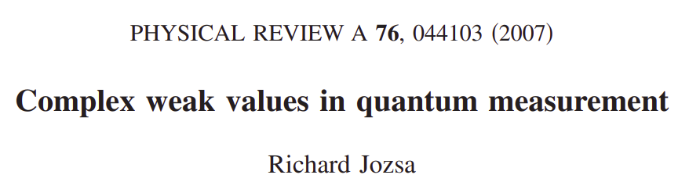
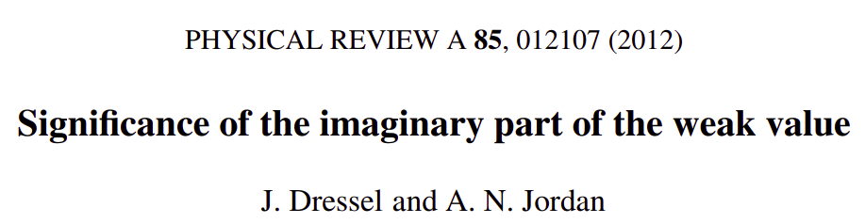

Slide 13


Weak value
Definition:

Slide 14
Weak value
Definition:

Slide 15
Weak value
Observable:
Pre-selected state:
Post-selected state:
Definition:

Slide 16

Weak value
Observable:
Pre-selected state:
Post-selected state:
Definition:
Expectation value:

Slide 17
Weak value
Observable:
Pre-selected state:
Post-selected state:
Complex number
Definition:
Expectation value:

Slide 18

Weak value
Observable:
Pre-selected state:
Post-selected state:
Complex number
Real
Imaginary

Slide 19
Weak value
Observable:
Pre-selected state:
Post-selected state:
Complex number
Real
Imaginary
Observable in the limit of minimal disturbance

Slide 20
Weak value
Observable:
Pre-selected state:
Post-selected state:
Complex number
Definition:
Expectation value:

Slide 21
Weak value
Observable:
Pre-selected state:
Post-selected state:
Complex number
Not bounded by eigenvalues
Definition:
Expectation value:

Slide 22


Stern-Gerlach
Spin
Position

Slide 23
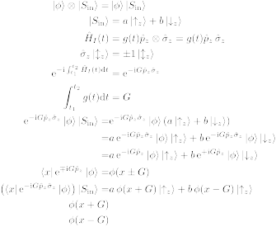
Stern-Gerlach
N
S

Slide 24
Stern-Gerlach
N
S

Slide 25
Example of standard measurement
(Von Neumann scheme)

Slide 26
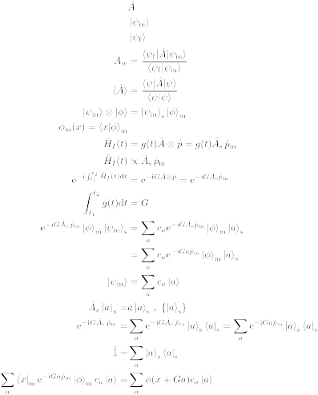
Example of standard measurement
(Von Neumann scheme)
Two quantum states
System
Meter / Auxiliary

Slide 27
Example of standard measurement
(Von Neumann scheme)
Two quantum states
System observable

Slide 28
Example of standard measurement
(Von Neumann scheme)
Two quantum states
System observable

Slide 29
Example of standard measurement
(Von Neumann scheme)
Two quantum states
System observable
Interaction Hamiltonian

Slide 30
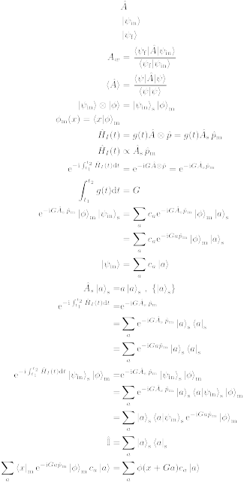
Example of standard measurement
(Von Neumann scheme)
Effect of the interaction Hamiltonian

Slide 31
Example of standard measurement
(Von Neumann scheme)
Effect of the interaction Hamiltonian
Interaction strength

Slide 32
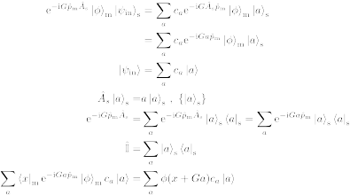
Example of standard measurement
(Von Neumann scheme)
Effect of the interaction Hamiltonian

Slide 33
Example of standard measurement
(Von Neumann scheme)
Effect of the interaction Hamiltonian

Slide 34
Example of standard measurement
(Von Neumann scheme)
Effect of the interaction Hamiltonian

Slide 35
Example of standard measurement
(Von Neumann scheme)
Effect of the interaction Hamiltonian

Slide 36
Example of standard measurement
(Von Neumann scheme)
Effect of the interaction Hamiltonian
Translation operator

Slide 37
Example of standard measurement
(Von Neumann scheme)
Overall effect

Slide 38
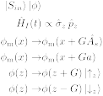
Example of standard measurement
(Von Neumann scheme)
Overall effect
Eigenvalue
Interaction strength

Slide 39
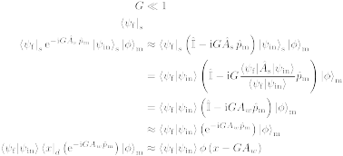
Weak measurement
Effect of the interaction Hamiltonian

Slide 40
Weak measurement
Effect of the interaction Hamiltonian

Slide 41
Weak measurement
Effect of the interaction Hamiltonian
Post-selection

Slide 42
Weak measurement
Effect of the interaction Hamiltonian

Slide 43
Weak measurement
Effect of the interaction Hamiltonian
Weak value of

Slide 44
Weak measurement
Effect of the interaction Hamiltonian

Slide 45
Weak measurement
Effect of the interaction Hamiltonian
Translation operator

Slide 46
Weak measurement
Overall effect

Slide 47
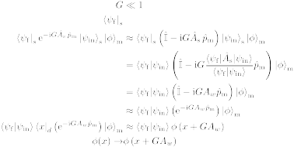
Weak measurement
Overall effect
Weak value
Interaction strength

Slide 48
Stern-Gerlach weak measurement

Slide 49
Stern-Gerlach weak measurement
N
S

Slide 50
Stern-Gerlach weak measurement
N
S

Slide 51
Stern-Gerlach weak measurement
N
S

Slide 52
Stern-Gerlach weak measurement
N
S

Slide 53
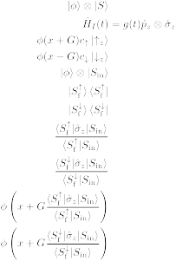
Stern-Gerlach weak measurement
N
N
S
S

Slide 54

Stern-Gerlach weak measurement
Spin weak value:
N
N
S
S

Slide 55
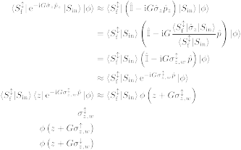
Stern-Gerlach weak measurement
N
N
S
S

Slide 56
Stern-Gerlach weak measurement
N
N
S
S

Slide 57
First paper on weak values

Slide 58
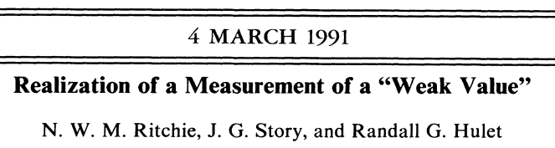
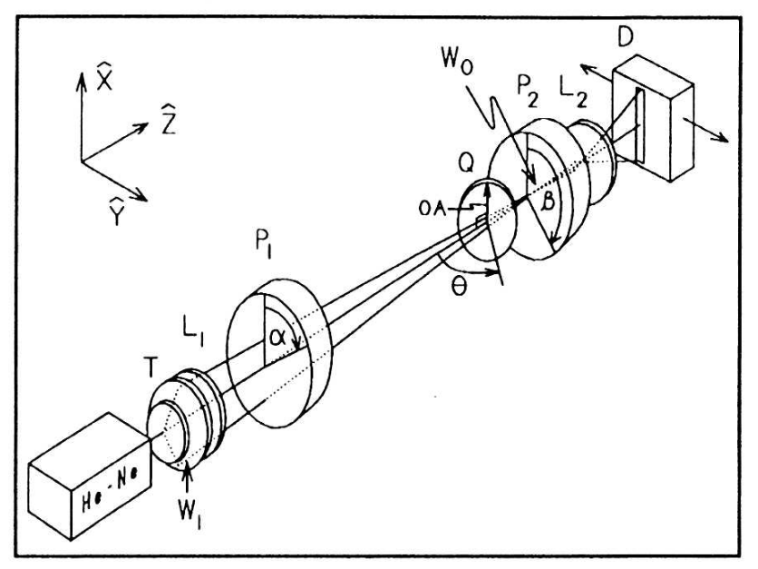
First measurement of weak values

Slide 59
What are they good for?

Slide 60
Theory and experiment
Quantum amplification
Quantum paradoxes
Negative quasi-probability distributions
Uncertainty relations

Slide 61
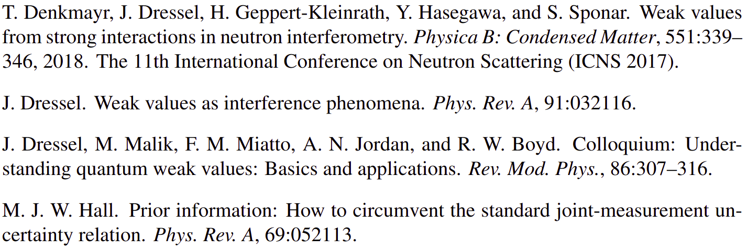
Theory and experiment
Quantum amplification
Quantum paradoxes
Negative quasi-probability distributions
Uncertainty relations
And more...

Slide 62
“In between” evolution of a system
Minimal disturbance
Non-commuting observables

Slide 63

Interferometry
Two level system = spinor
“Spin” state

Slide 64
Interferometry
Two level system = spinor
“Spin” state
“Spin”
projection

Slide 65
Do we actually need a weak measurement?

Slide 66
Weak value
Definition:

Slide 67
Weak value
No mention of interaction strength
No mention of meter/auxiliary state
Definition:

Slide 68
Part 2: Weak values based description of interferometry

Slide 69
Weak values and interferometry
Standard interferometry formalism

Slide 70
Weak values and interferometry
Standard interferometry formalism

Slide 71
Weak values and interferometry
Standard interferometry formalism

Slide 72
Weak values and interferometry
Standard interferometry formalism

Slide 73

Weak values and interferometry
Standard interferometry formalism
Measured intensity

Slide 74
Weak values and interferometry
Standard interferometry formalism
Measured intensity

Slide 75
Weak values and interferometry
Standard interferometry formalism
Measured intensity

Slide 76
Weak values and interferometry
Standard interferometry formalism
Measured intensity

Slide 77
Weak values and interferometry
Weak value picture

Slide 78
Weak values and interferometry
Weak value picture
Pre-selection

Slide 79
Weak values and interferometry
Weak value picture
Pre-selection
Interaction

Slide 80

Weak values and interferometry
Weak value picture
Pre-selection
Interaction

Slide 81
Weak values and interferometry
Weak value picture
Pre-selection
Interaction
Post-selection

Slide 82
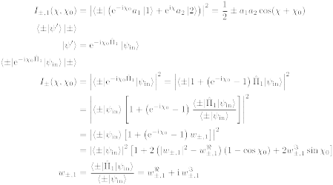
Weak values and interferometry
Weak value picture
Measured intensity

Slide 83
Weak values and interferometry
Weak value picture
Measured intensity

Slide 84
Weak values and interferometry
Weak value picture
Measured intensity

Slide 85
Weak values and interferometry
Weak value picture
Measured intensity
Path weak value

Slide 86
Weak values and interferometry
Weak value picture
Measured intensity

Slide 87
Weak values and interferometry
Weak value picture
Measured intensity

Slide 88
Weak values and interferometry
Weak value picture
Measured intensity

Slide 89
Weak values and interferometry
Weak value picture
Measured intensity
Amplitude
square

Slide 90
Weak values and interferometry
Weak value picture
Measured intensity
Real part
Amplitude
square

Slide 91
Weak values and interferometry
Weak value picture
Measured intensity
Real part
Amplitude
square
Imaginary
part

Slide 92
Weak values and interferometry
Weak value picture
Measured intensity

Slide 93

Weak values and interferometry
Weak value picture
Measured intensity

Slide 94
Weak values and interferometry
Weak value picture
Measured intensity

Slide 95
Weak values and interferometry
Weak value picture
Measured intensity

Slide 96
Weak values and interferometry
Almost there...

Slide 97
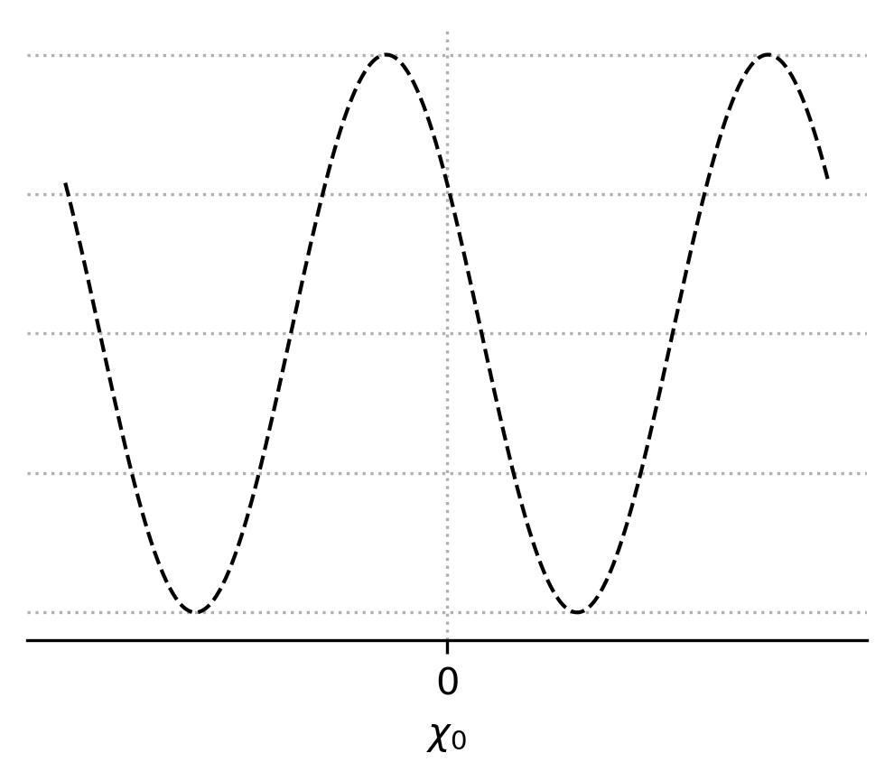
Weak values and interferometry
Almost there...
Interferogram

Slide 98
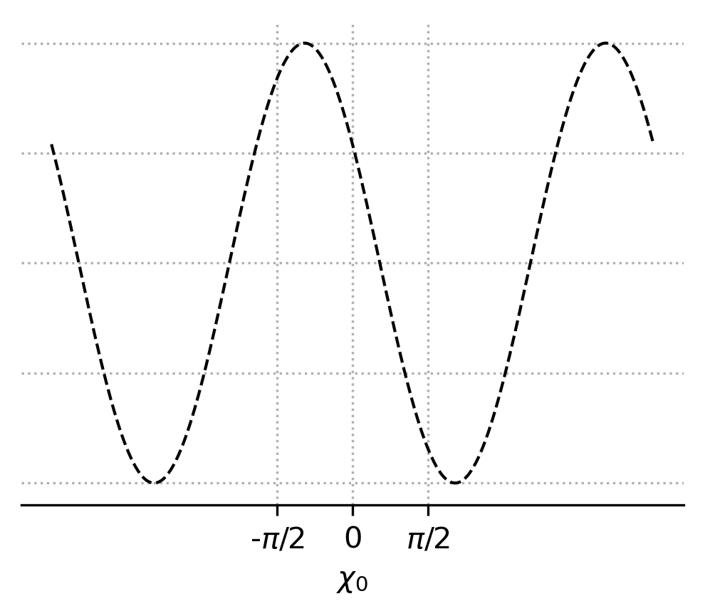
Weak values and interferometry
Almost there...
Interferogram

Slide 99
Weak values and interferometry
Almost there...

Slide 100
Weak values and interferometry
Almost there...

Slide 101
Weak values and interferometry
Almost there...

Slide 102
Weak values and interferometry
Almost there...
2nd order equation

Slide 103
Weak values and interferometry
Almost there...
2nd order equation
2 solutions

Slide 104
Weak values and interferometry
Almost there...

Slide 105

Weak values and interferometry
Almost there...

Slide 106
Weak values and interferometry
Path blocker

Slide 107

Weak values and interferometry
Weak value picture
Pre-selection
Interaction
Post-selection
Path blocker

Slide 108
Weak values and interferometry
Measured intensity

Slide 109
Weak values and interferometry
Measured intensity

Slide 110
Weak values and interferometry
Measured intensity

Slide 111
Weak values and interferometry
We got there!

Slide 112
I am running out of time, unexpectedly...

Slide 113
Part 3: Experimental measurement of path weak value from interferograms

Slide 114

Neutron interferometer

Slide 115
Setup

Slide 116
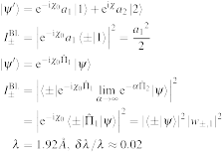
Setup
Unpolarised
neutron beam
1
1

Slide 117
Setup
Unpolarised
neutron beam
1
2
Neutron
interferometer
2
1

Slide 118
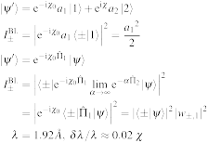
Setup
Unpolarised
neutron beam
1
2
Neutron
interferometer
2
1
Phase-shifter
3
3

Slide 119
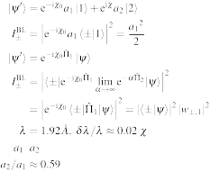
Setup
Unpolarised
neutron beam
1
2
Neutron
interferometer
2
1
4
Phase-shifter
3
3
Indium foils
to adjust path
amplitudes
4

Slide 120
Setup
Unpolarised
neutron beam
1
5
2
Neutron
interferometer
2
1
4
Phase-shifter
3
3
Indium foils
to adjust path
amplitudes
4
Cadmium
path blocker
5

Slide 121
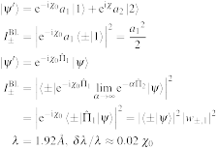
Setup
Unpolarised
neutron beam
1
5
2
Neutron
interferometer
2
1
4
Phase-shifter
3
3
6
Indium foils
to adjust path
amplitudes
4
Cadmium
path blocker
Phase-shifter
5
6

Slide 122
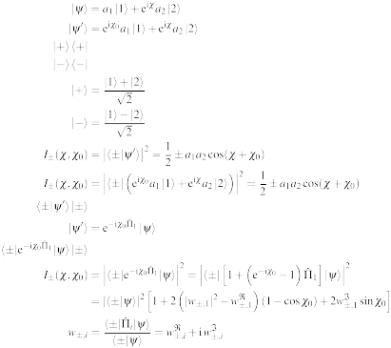
Setup
Unpolarised
neutron beam
1
5
2
Neutron
interferometer
2
1
4
7
Phase-shifter
3
3
6
Indium foils
to adjust path
amplitudes
8
4
Cadmium
path blocker
Phase-shifter
-detector
5
6
-detector
7
8

Slide 123
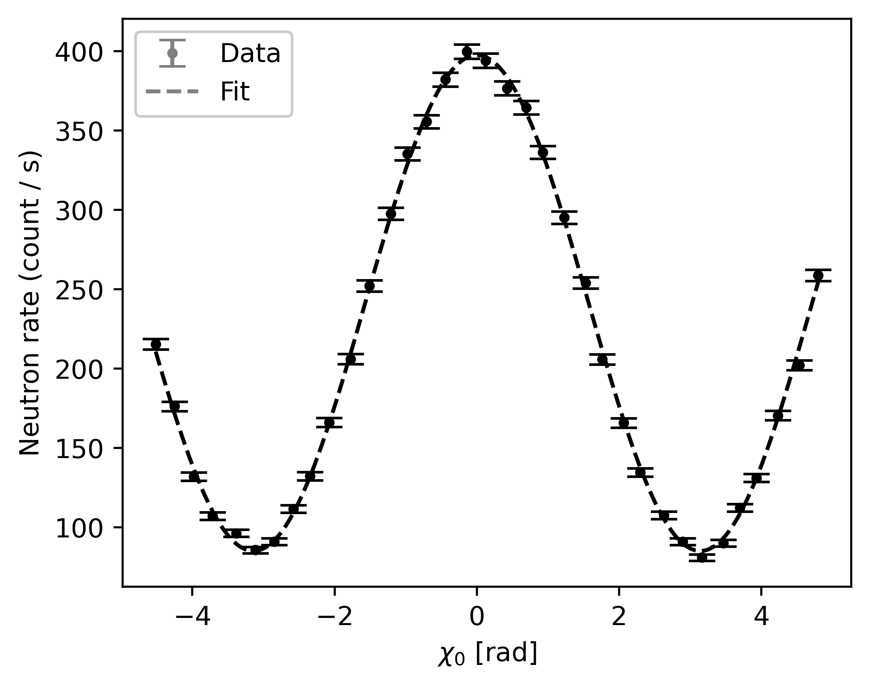
Example of interferogram

Slide 124
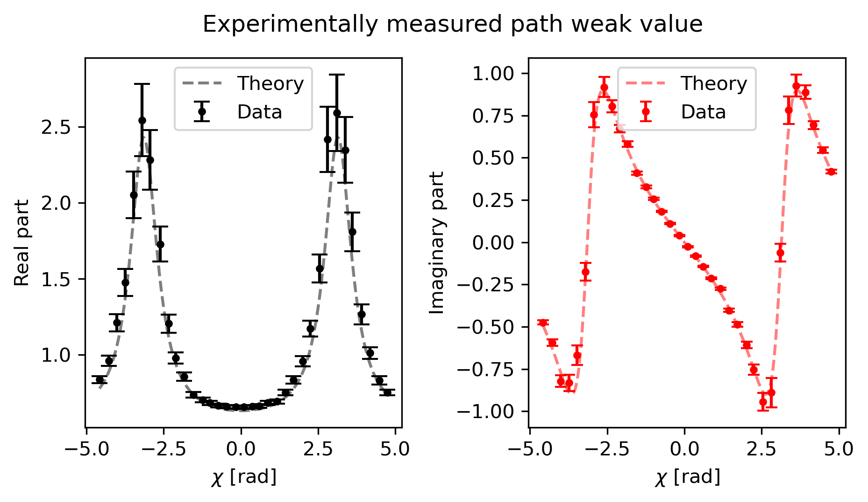
Results: Weak value of path 1

Slide 125
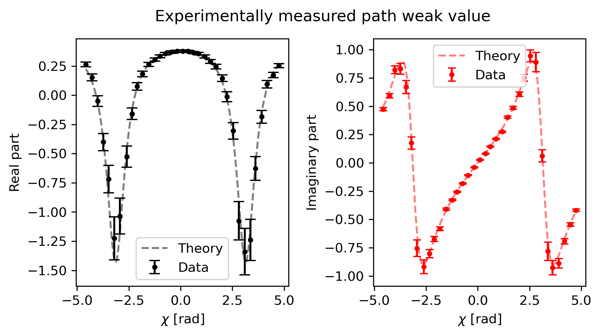
Results: Weak value of path 2

Slide 126
Interpretation of the results

Slide 127

Interpretation of the results

Slide 128
Summary
Introduction to weak values and weak measurements
Weak values based description of a Mach-Zehnder interferometer
Experimental measurement of path weak values directly from interferograms

Slide 129
Summary
To be continued...

Slide 130


Aknowledgements
I. V. Masiello¹, A. Dvorak¹, H. Lemmel^{1,2}, and Y. Hasegawa^{1,3}
¹Atominstitut, TU Wien, Stadionallee 2, 1020 Vienna, Austria
²Institut Laue-Langevin, 71 avenue des Martyrs, 38000 Grenoble, France
³Department of Applied Physics, Hokkaido University, Kita-ku, Sapporo 060-8628, Japan

Slide 131
Thanks for your time!

